Slide 1



Full-stack cloud-based web applications at Nintendo
Capstone presentation by Ethan Silvas Faculty advisor: Professor Nancy Kool

Slide 2

My role
Full-stack developer
Developed 3 web pages of internal web application
Wrote unit tests during UAT
Notes:
My role?

Slide 3

My project: Digital Content Accounting
Helps business systems analysts calculate costs and revenue
Created a UI that performed CRUD database calls and AWS services
Cloud-based using Amazon RDS

Slide 4
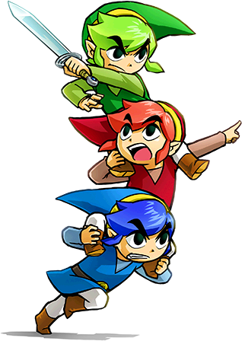
My contribution
Had full responsibility for my pages across the stack
Communicated with users to solve bugs and design new features
Took part in every SDLC phase except production

Slide 5

Project Timeline
Week 1: Researched other Nintendo projects
Week 2: Defined CRUD calls from MySQL to Python
Week 3: Created an AWS API Gateway to convert the CRUD calls to REST calls
Week 4: Built the UI

Slide 6

Challenges
Sprint was originally 4 weeks, but was cut down to 3.
Had to learn new AWS technologies: Lambda, API Gateway, and CloudWatch
Learning how to communicate with non-technical team members

Slide 7




Main tools
Frontend
Middleware
Backend

Slide 8

Communication within my team
Wagile SDLC
Daily standups with team and users
Jira tickets

Slide 9



Other Tools Used

Slide 10
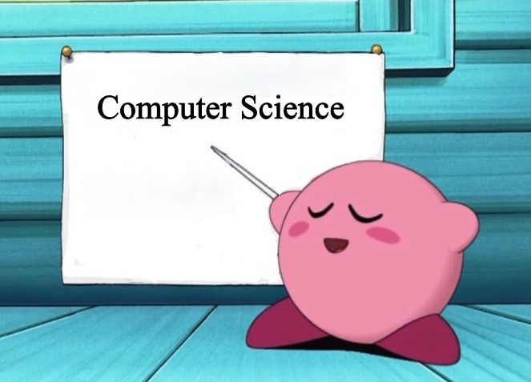
Relevant Courses
CSS 360
CSS 301
CSS 342
CSS 343

Slide 11
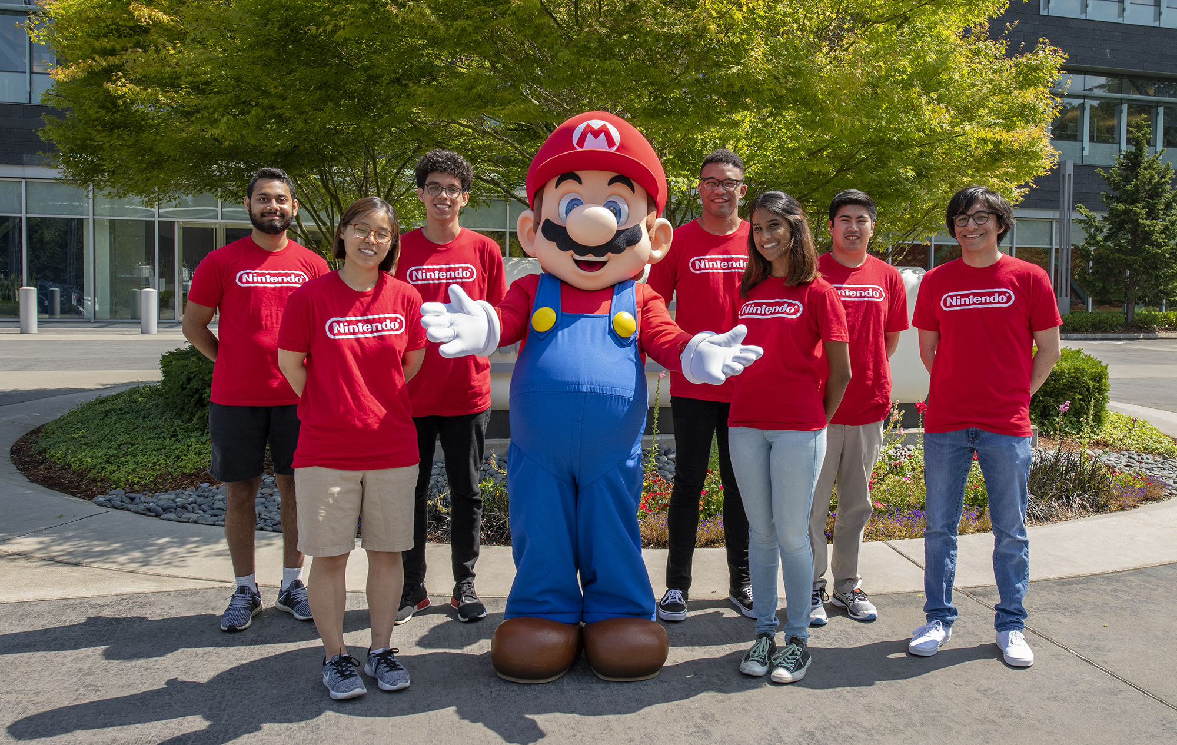
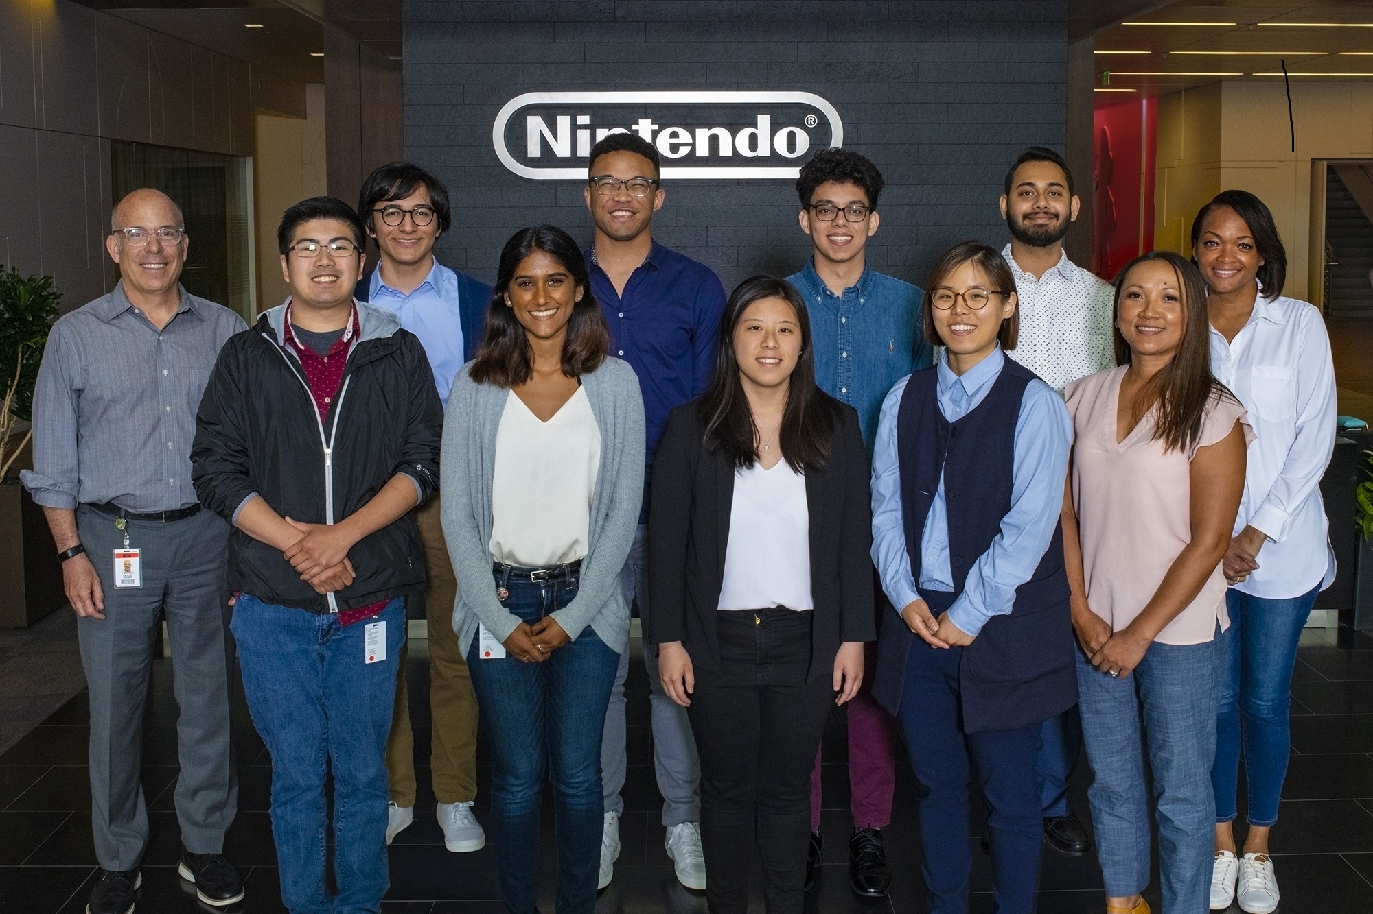
Takeaways and Moving forward
Experience with the top tools in the industry
Full responsibility as a full-stack developer
Developed my business acumen

Slide 12
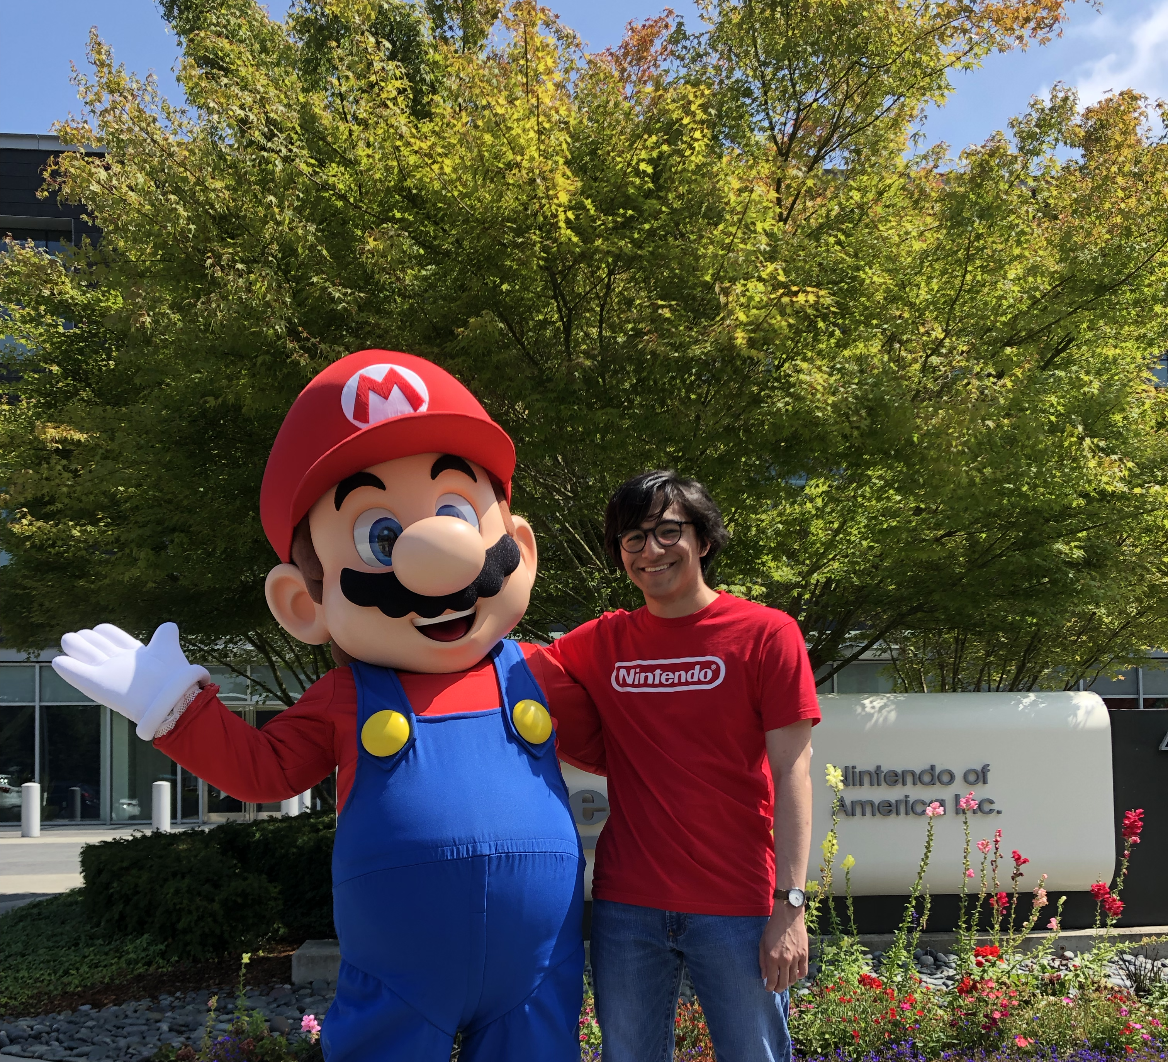
Thank you!

